Slide 1
Register Transfer and Micro operations
UNIT-2

Slide 2
Register Transfer Language
Digital system is interconnections of digital hardware that accomplish a specific information processing task.
Digital systems are defined by registers they contain and operations they performed.
The operations on the data in registers are called microoperations.
Micro operations are Elementary operations. Examples of micro-operations are 1. Shift 2. Load 3. Clear 4. Increment

Slide 3
Register Transfer Language
Internal hardware of digital computer is best defined by specifying:
The set of register it contains.
The sequence of micro operations performed on binary information stored in registers.
The control that initiate the sequence of micro operations.

Slide 4
Register Transfer Language
The symbolic notation used to describe the micro operations transfers among registers is called Register Transfer Language.

Slide 5
Register Transfer
Computer registers are designated by capital letter.
MAR, PC, IR, R1
Registers are combination of flip flops.
Flip flops are labeled from 0 to n-1. (from right to left)

Slide 6
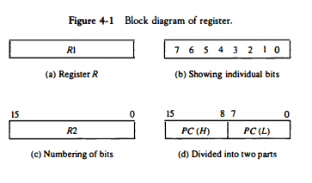
Block Diagram of Register

Slide 7
Register Transfer
R2<-R1 transfer content of R1 to R2.
Transfer is performed on predefined control condition.
If (P=1) then (R2<-R1)
where P is control signal
Control function is a Boolean variable that is equal to 1 or 0.
P: R2<-R1

Slide 8
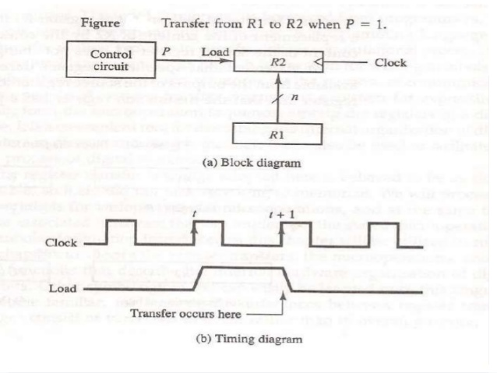
Register Transfer

Slide 9
Microoperations
Register transfer operation (one register to another)
Arithmetic microoperations (numeric data stored in register)
Logic microoperations
Shift microoperations (Shift operations on register)
Transfer operation doesn’t change the content.

Slide 10
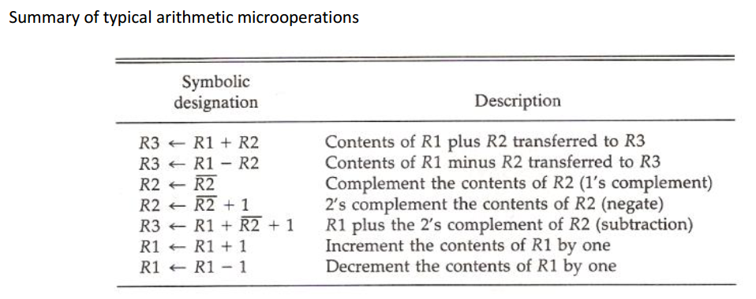
Arithmetic Operations

Slide 11
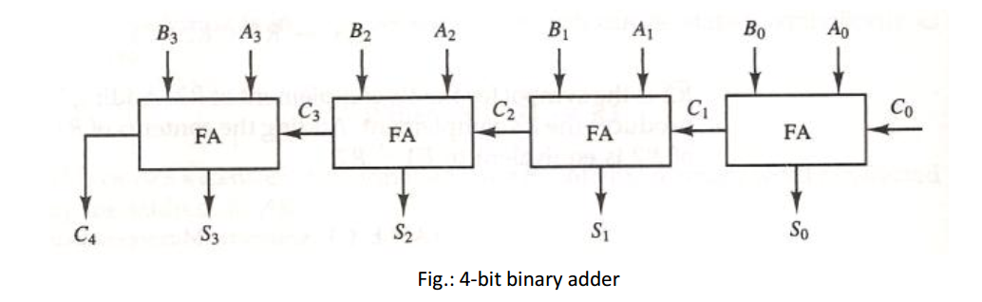
Binary Adder

Slide 12
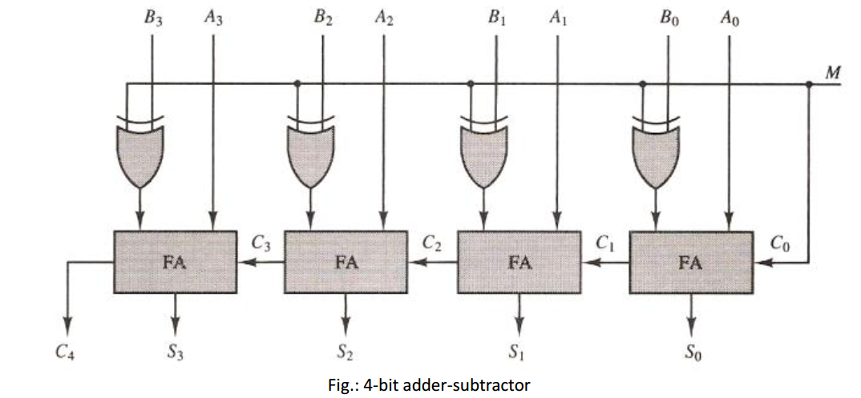
Binary Adder and Subtractor

Slide 13
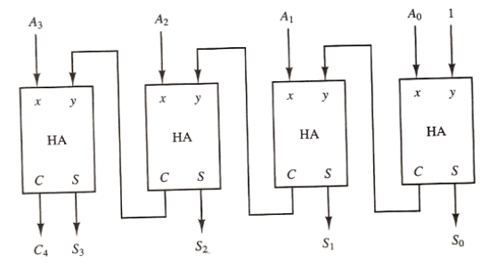
Binary Incremental

Slide 14
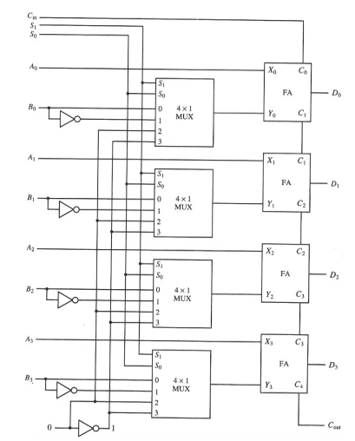
Arithmetic Circuit

Slide 15
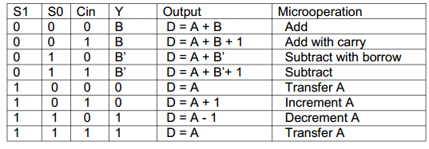
Arithmetic Operations

Slide 16
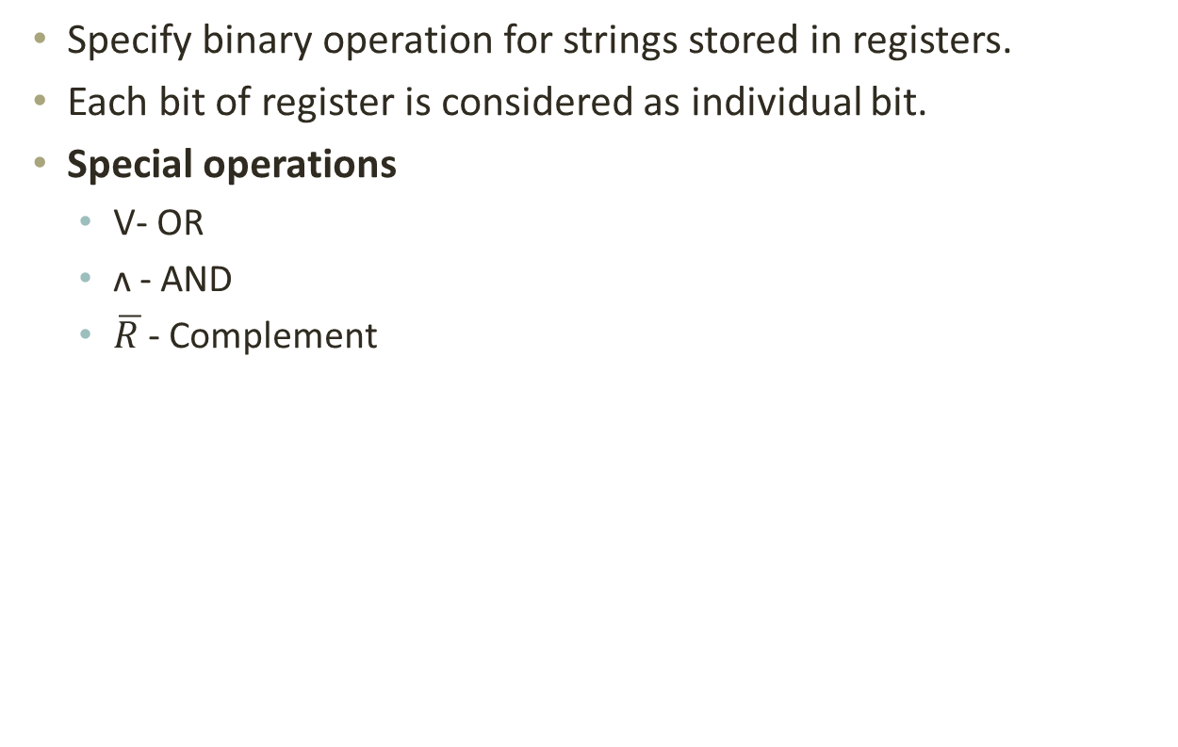
Logic Micro operation
Specify binary operation for strings stored in registers.
Each bit of register is considered as individual bit.
Special operations
V- OR
ʌ - AND
$\overline{R }$- Complement

Slide 17
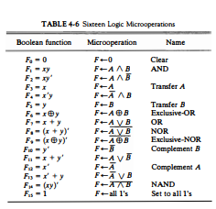

Slide 18


Slide 19
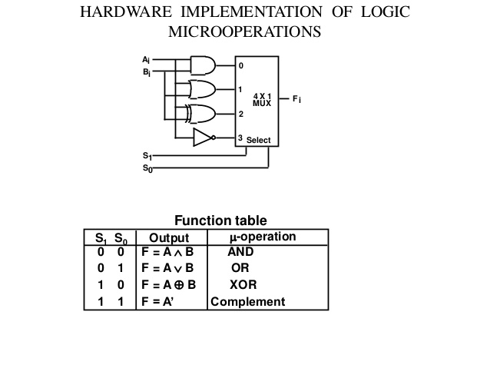
Logic Micro operations

Slide 20
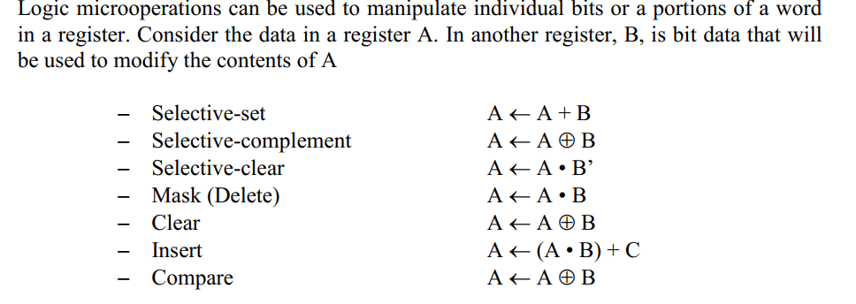
Applications of Logic Micro-operation

Slide 21
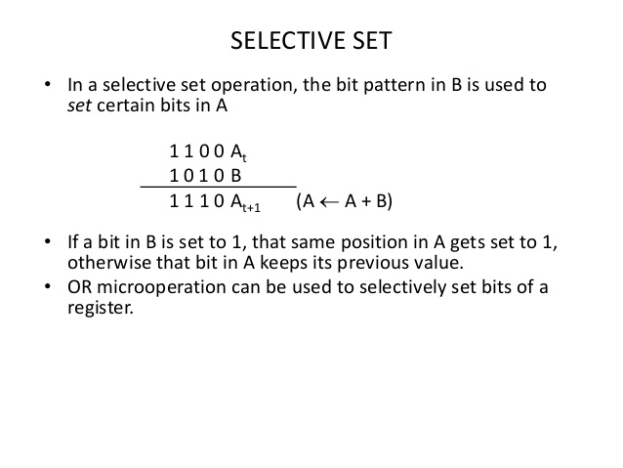

Slide 22
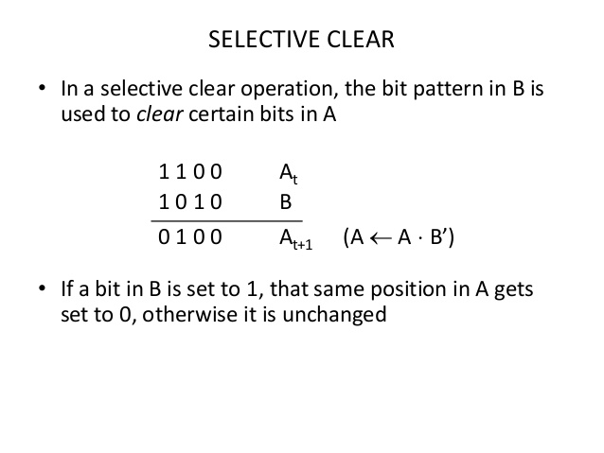

Slide 23
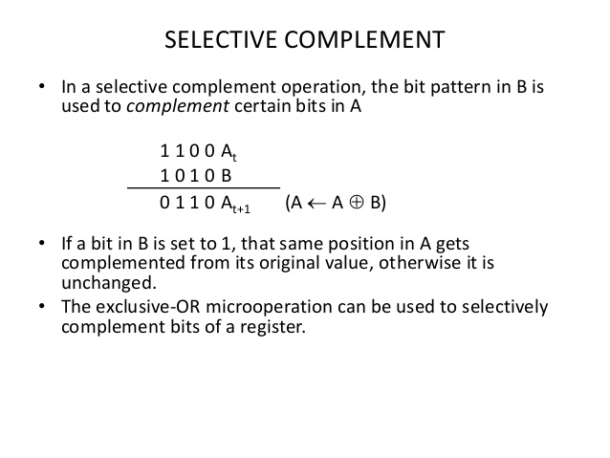

Slide 24
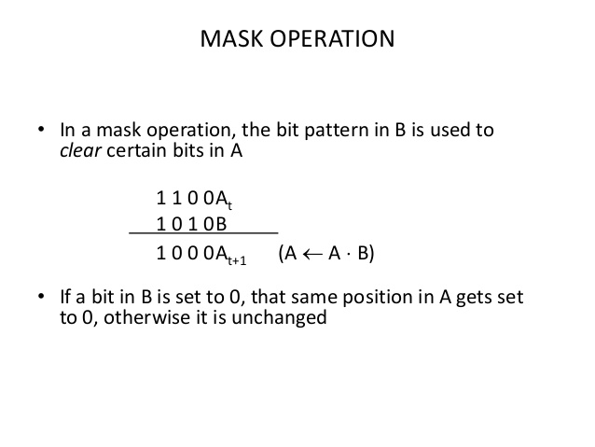

Slide 25
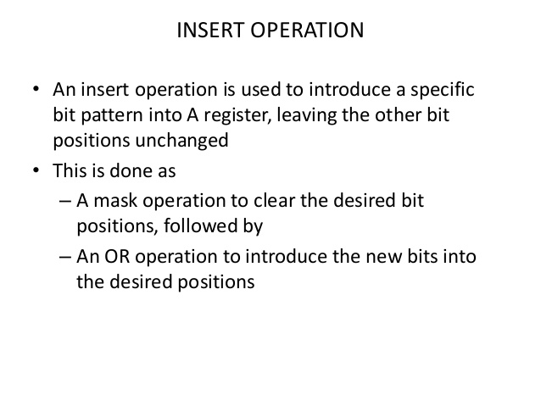

Slide 26
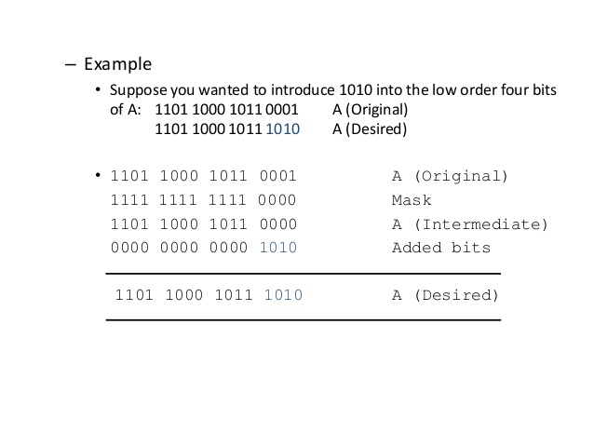

Slide 27
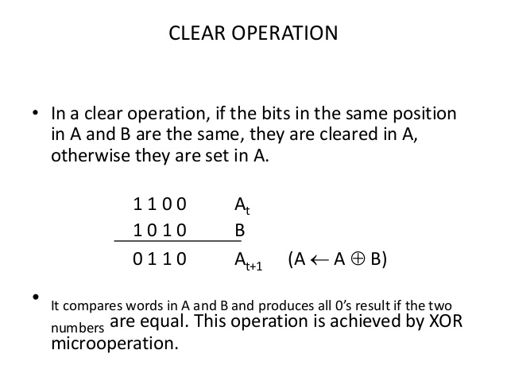

Slide 28
Shift micro-operations
Uses for serial transfer of data.
Also used with arithmetic and logic operation.
Content can be shifted left and right.
While transferring the first flip-flop gets input from serial input.
For left shifting- serial input is given to rightmost flip-flop
For right shifting-serial input is given to leftmost flip-flop

Slide 29
Types of Shift operations
1. Logical shift- 0 is transfer through serial input.
R1<- shl R1
R1<- shr R1
2. circular shift-circulates bit of the register around two end without loss of information.
R1<- cil R1
R1<- cir R1
3. Arithmetic shift- shifts a signed binary number to left or right.
R1<- ashl R1
R1<- ashr R1

Slide 30
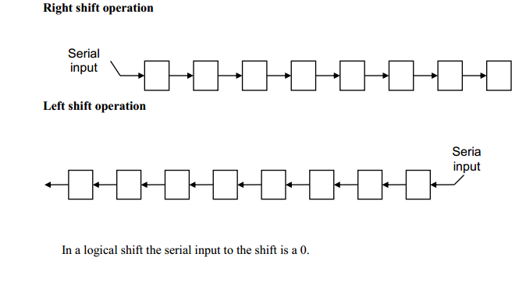
Logical shift

Slide 31
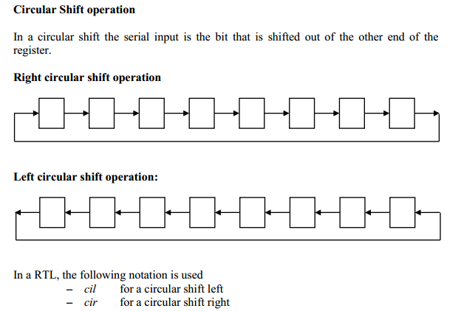
Circular shift

Slide 32
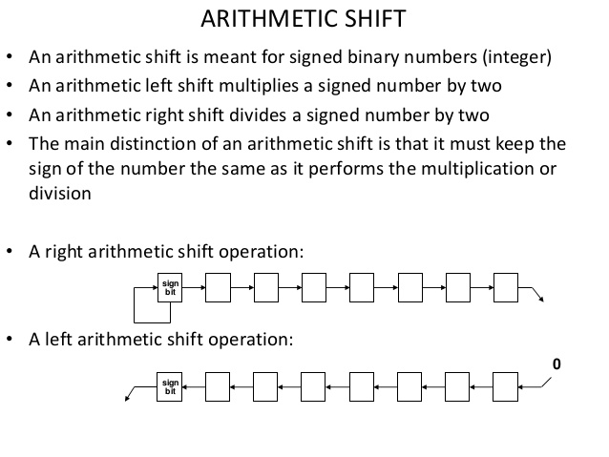
Arithmetic shift

Slide 33
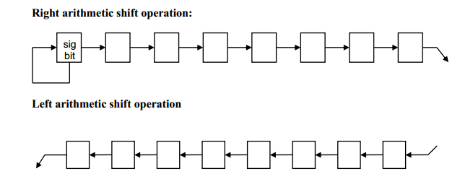
Arithmetic shift

Slide 34
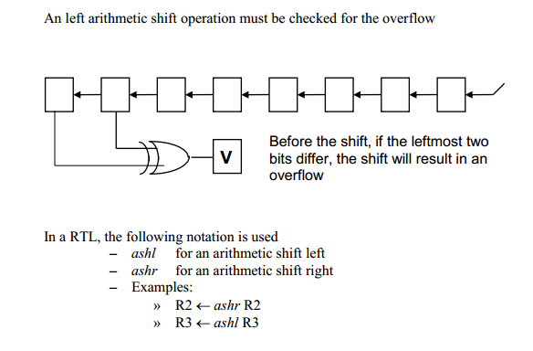
Arithmetic shift

Slide 35
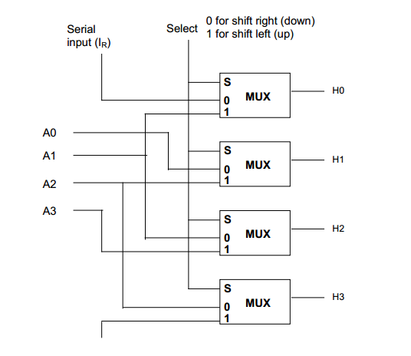
Hardware implementation of shift

Slide 36
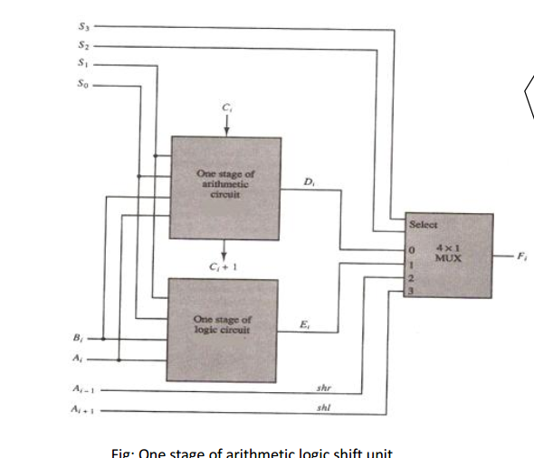
ALU

Slide 37
